Slide 1
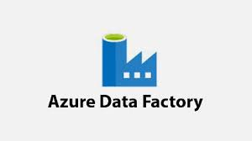
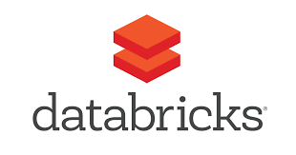
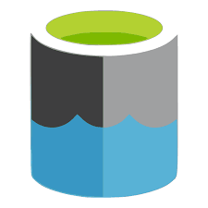
2
Training model
4
3
5
1
1. Azure Data Factory (ADF) Pipeline is triggered when new file is added to Storage
2. ADF runs Databricks notebook
3. Databricks cluster execute notebook code to read data from Storage
4. Databricks cluster train ML model
5. Databricks cluster save trained model file to Storage

Slide 2
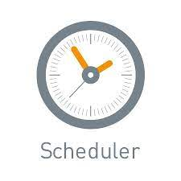
Generator
Generate dummy data and run prediction
1
Prediction
4
2
3
5
1. Databricks Cluster executes Data Generator Notebook execute
2. New data is added into parquet file in Storage
3. Spark stream continuously looking for new data starts execution in Prediction notebook
4Prediction is generated and results are sent back to parquet file
5. Databricks cluster save trained model file to Storage

